Slide 1
State of Mobile Linux
Juha-Matti Liukkonen, Jan 5, 2011

Slide 2
Contents
Why is this interesting in a Qt course?
Mobile devices vs. desktop/server systems
Android, Maemo, and MeeGo today
Designing software for mobile environments

Slide 3
Why is this interesting in a Qt course?

Slide 4
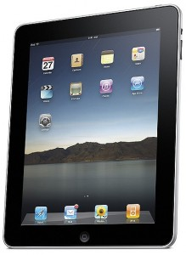
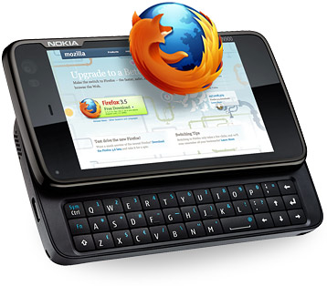
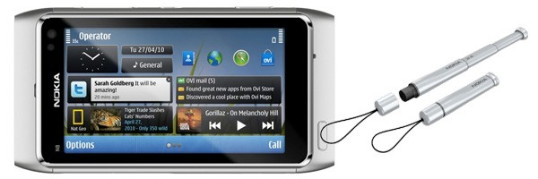
Rationale
Advances in technology make computers mobile
Low-power processors, displays, wireless network chipsets, …
Laptops outsell desktop computers
High-end smartphones = mobile computers
Need to know how to make software function well in a mobile device
Qt is big part of Symbian & Maemo/MeeGo API
iSuppli, Dec 2008
Nokia terminology

Slide 5
Developing software for mobiles
In desktop/server computing:
Java :== server C/C++ :== desktop
Qt was initially developed for desktop applications.
Mobile devices today are more powerful than the desktops 10 years ago.
Android smartphones
Eclipse, Java
Symbian smartphones
NetBeans / Eclipse, Java ME
Qt Creator, C/C++
Maemo / MeeGo smartphones
Qt Creator, C/C++
Of particular interest in this course.

Slide 6
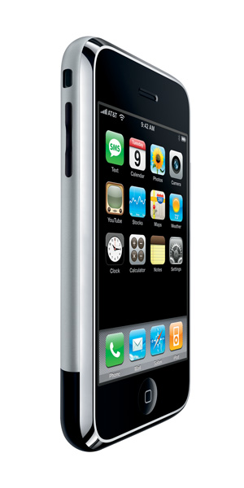
The elephant in the room
In 2007, Apple change the mobile world with the iPhone
Touch user interface, excellent developer tools, seamless services integration, …
Modern operating system, shared with iPod and Mac product lines
Caught “industry regulars” with their pants down
Nokia, Google, Samsung, et al – what choice do they have? Linux!
We don’t talk about the iPhone here.

Slide 7
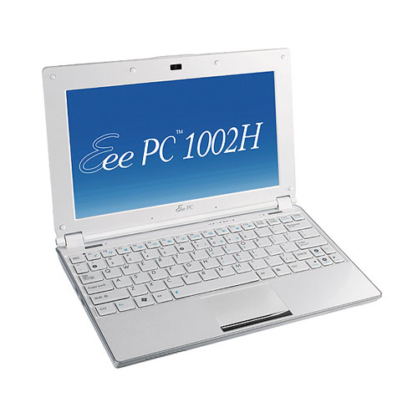
iPad “killed the netbook”
In 2010, Apple introduced another mobile game changer
iPad = basically, a scaled-up iPhone with a 10” touch screen
Bigger case = can fit bigger battery, for ~10 hours of intensive use
7,5 million sold as of Sep 30, 2010
Phenomenal netbook sales growth fizzled
Apple, 2010
NPD, Morgan Stanley Research, 2010

Slide 8
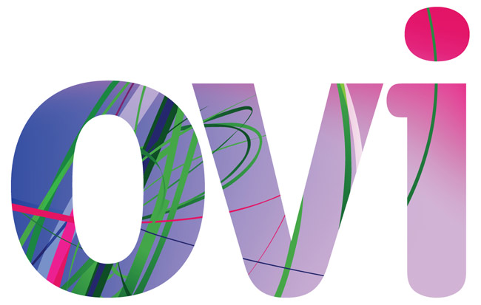
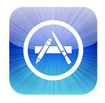
App ecosystems
Powerful mobile computers can run variety of software
Dynamic availability of applications to provide added value over device lifetime
Devices become multi-purpose and adaptable
Voice call functionality a secondary feature
New software design challenges
New user interaction models
Preservation of battery
Nokia was ahead of its time with the Communicator concept back in 1996.

Slide 9
Mobile device constraints
Mobility = situations change
May lose network coverage
May run out of battery
Software needs to adapt to situation at hand
Mobility = limited resources
CPUs, GPUs not as fast as on desktop systems
Smaller screens, different input devices
Limited amount of battery power
Network connections error out.
Your app dies while writing to a file.
Your app is frozen to let a call through.

Slide 10
Cross development
Cannot compile software in the target device
Not enough memory, disk space, CPU power
Poor input/output devices for development
Must use a cross-compile environment
SDK = Software Development Kit
Build software in e.g. QtCreator, compile with SDK tools, install & run in the target device
Debugging software in target is often a bit tricky. Most SDKs come with a device emulator.

Slide 11
Mobile Linux distributions

Slide 12
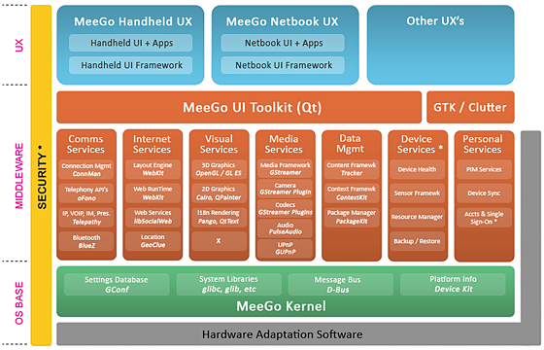
Linux Distribution
Linux is the operating system kernel
Deals with hardware abstraction
A distribution is a managed collection of software, including the kernel
Device drivers, middleware, user applications
Comes with distributor-defined default settings and applications
Often optimized for specific use(s)
E.g. Ubuntu, Red Hat Enterprise Linux, Maemo

Slide 13
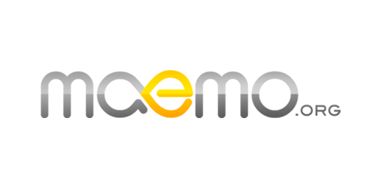
Mobile Linux distributions
Maemo
Nokia’s Linux distribution for Internet tablets and high-end smartphones
Powers the N770, N800, N810, N900
Android
Google’s Linux distribution for Internet tablets and smartphones
Powers many HTC devices, Nexus One, etc.

Slide 14
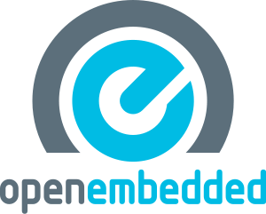
Mobile Linux distributions
OpenEmbedded
Open source project
Best suited for custom adaptations to very small devices
MeeGo
New kid on the block
Combines Intel’s Moblin netbook Linux and Nokia’s Maemo Linux
First MeeGo devices out in fall 2010

Slide 15
Android details
Uses custom Linux kernel
Google maintains a set of Android patches
Applications developed using Java
Google’s custom Dalvik Java VM
6 versions in active use
1.5, 1.6, 2.0, 2.1, 2.2 and now 2.3
Used in various smartphones by HTC, Google, Motorola, LG, etc.
There is also a Native Development Kit (NDK) for building native Linux applications.
The devices have a bit different resolutions and feature sets.

Slide 16
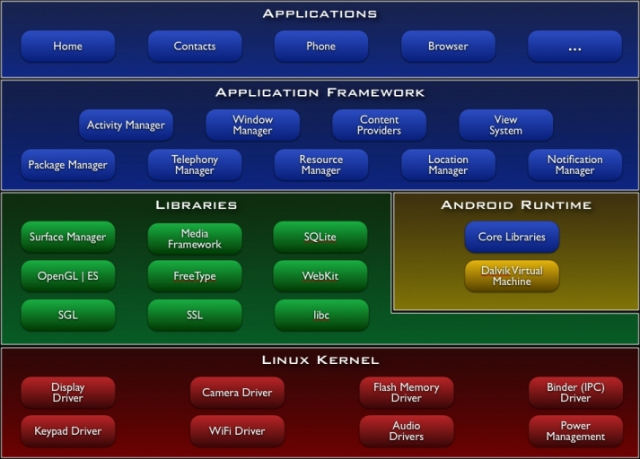
Android architecture

Slide 17
Android points of interest
Custom C library
C library = system calls (interface to kernel), POSIX & ANSI standard library routines
Linux standard is glibc, which is a bit bloated
Android has a stripped down libc
Compatibility issues for generic Linux code
Custom application installation
Apps bundled into .apk “Android packages”

Slide 18
Android points of interest
Programming model
Activity
Impements an application view
Service
Background program with no UI
Broadcast receiver
Listens for e.g. battery notifications
Content provider
Shares data from an app

Slide 19
Android and Qt
Project Lighthouse = Qt for Android
Project ongoing… not ready for prime time yet
Some limitations of Android Native SDK (NDK) cause problems
Should eventually allow Qt to be the universal (mobile) Linux toolkit!
Google is not very supportive ;-)

Slide 20
Maemo details
Uses standard Linux kernel
Applications developed using Qt, C/C++
Maemo 4 & 5 are GTK based, but even there Qt is the recommended development toolkit
Maemo 4 used in Nokia N800 tablet (deprecated)
Maemo 5 used in Nokia N900 smartphone
Maemo 6 this fall -> MeeGo

Slide 21
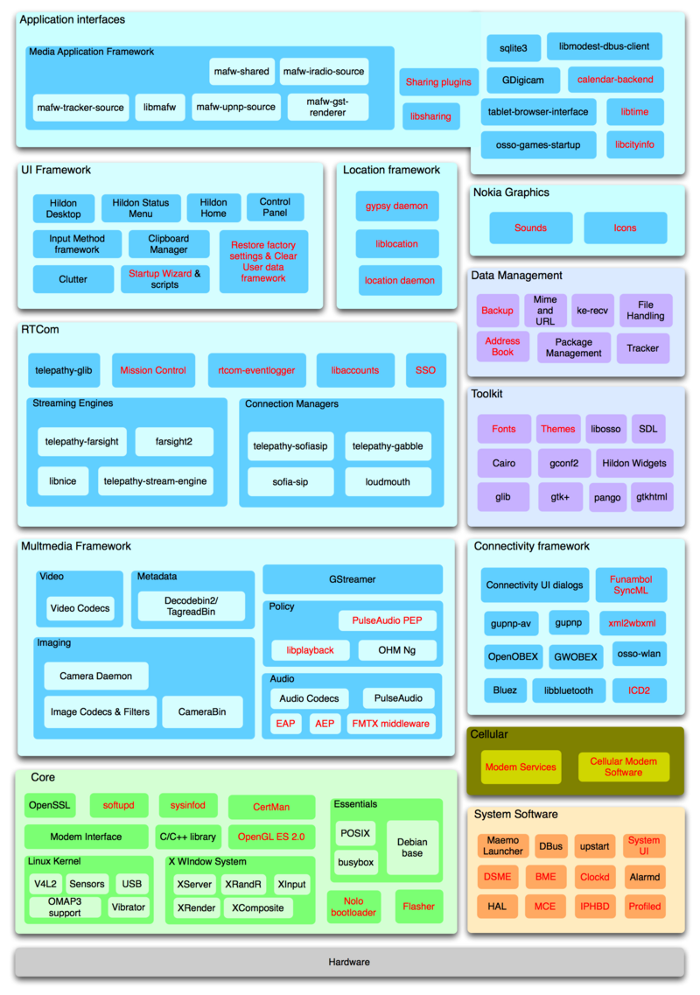
Maemo 5 architecture

Slide 22
Maemo points of interest
Very regular Linux in most ways
Debian based, uses dpkg & apt-get
Uses glibc, gstreamer, X.org, etc.
User interface based on Hildon/GTK+
Clutter backend for fancy effects
Qt natively supported
Qt apps for Maemo 5 have the Maemo look & feel, support touch input, etc.
Nokia SDK = QtCreator + SDKs for Symbian/Maemo

Slide 23
MeeGo details
Uses standard Linux kernel
Applications developed using Qt, C/C++
Replaces both Moblin from Intel, and Maemo from Nokia
Some products released already
Alpha quality 1.0 release May 2010
Beta quality 1.1 release Oct 2010
Product quality 1.2 release Apr 2011

Slide 24
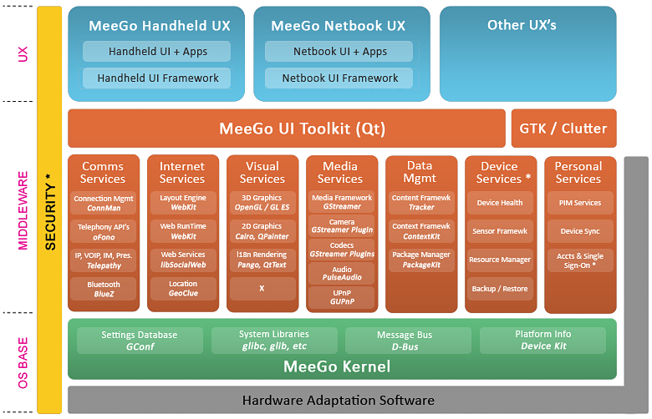
MeeGo architecture

Slide 25
MeeGo points of interest
Mostly regular Linux
Glibc, gstreamer, ALSA, etc.
Not based on any existing distribution, but uses rpm & zypper for package management
User interface modules separated from base platform
Different user interaction models for different use scenarios
Qt is the primary application interface

Slide 26
MeeGo points of interest
UX modules
Handheld: touchscreen (meegotouch toolkit on top of Qt)
Netbook: keyboard/mouse
Connected TV: remote control
In-Vehicle Information: touchscreen, joystick
Reference applications for each UX model
System vendors can customize as needed

Slide 27
MeeGo points of interest
Stable API
Any MeeGo application can run on any MeeGo certified system
Main part of API is Qt (Core, Gui, Mobility, …)
Also: gstreamer, sqlite, ALSA, D-BUS interfaces to various frameworks, etc.
Goal is to encourage an App Store ecosystem rivaling Apple

Slide 28
Why MeeGo is interesting to us
Only credible challenger to Android
Backed by Nokia -> direct impact to Finnish software development scene
Innovative architectural solutions
Aims to become the “industry standard” Linux for modern embedded systems
Will drive Qt development in mobile space
You can participate in building MeeGo: go to meego.com and become active!

Slide 29
Participate to MeeGo!
Go to meego.com and register as a developer
Participate in community working groups
Discuss in #meego at freenode
Contribute code, documentation, tests
Gain reputation, become a component maintainer
Steering group meetings in #meego-meeting
Help us create the future of mobile Linux!

Slide 30
Developing software for mobile Linux

Slide 31
Software design considerations
Mobile environment constraints
Limited battery power
Limited CPU power
Limited screen size
Changing situations
Not that difficult to work with, once you know what to avoid
Mobile optimized software runs fast on higher end hardware
Design your app for a CPU from 1990, graphics from 2005,
but use modern tools and techniques.

Slide 32
Limited battery power
Typical smartphone battery is around 1300-1500 mAh
An ARM Cortex A8 @ 600 MHz draws 300 mW - an Intel XEON @ 3 GHz draws 130W
Software must do as little as possible
Must not poll for network traffic, user input, ambient light sensors, …
Must not update the screen when in background
Use platform services for notifications
Applications must become context aware.

Slide 33
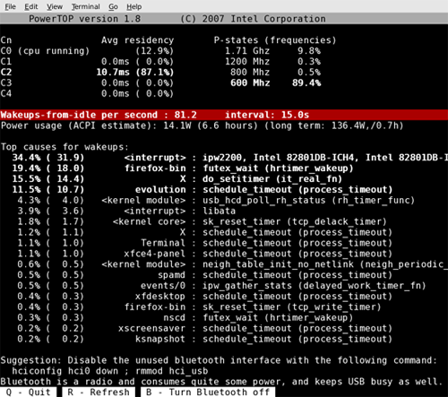
Tools: powertop

Slide 34
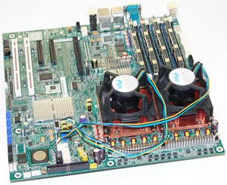
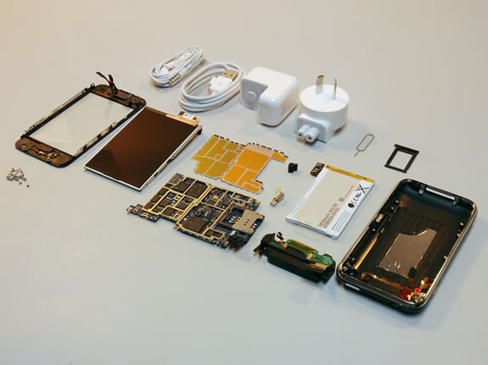
Limited CPU power
Desktop machines today use 2-4 CPU cores of 2-3 GHz each (4x3 GHz)
Server machines have 3-4x that
Netbooks and smartphones have 1-2 cores of 0.5-1 GHz
Level of parallelization is very different
Maximum throughput is very different
Efficient algorithms work on smartphone level CPUs, and scream on high-end computers

Slide 35
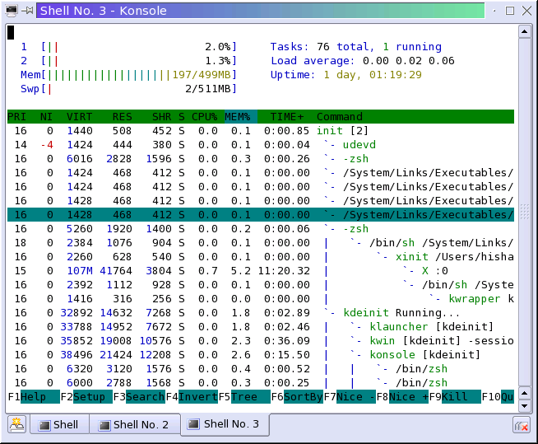
Tools: htop

Slide 36
Limited screen size
Laptops may have 17”, 1920x1200 screens
Netbooks have 7-13”, max 1280x800
Smartphones have 3-4”, max 860x480
Designing a scaling application UI is hard
Dialogs designed for 860x480 may look tiny on 1920x1200
Dialogs designed for 1920x1200 may simply not fit in 860x480
Also, what is the input mechanism?

Slide 37
Changing situations
May lose network coverage
Applications must degrade gracefully
May start to run out of power
Must absolutely minimize what apps do
Must survive power outages gracefully
Incoming phone call
Applications must yield immediately to allow the high priority task to run
You always do check for error values from API calls, right?
Database transactions and journaling file sys- tems are your friends.

Slide 38
User interaction
Device rotation
Mobile devices often have accelerometers – can tell whether it is in landscape or portrait mode
Applications should register for orientation change notifications and re-layout accordingly
Input methods
Hardware keyboard, virtual keyboard, finger input, Bluetooth keyboards and mice, …
Extra controls such as microphone buttons

Slide 39
Catching rotation on Maemo
MyReceiverClass inherits QObject, and implements slot orientationChanged().
MyReceiverClass * receiver = new MyReceiverClass(this);
QDBusConnection systemBus = QDBusConnection::systemBus();
systemBus.connect("com.nokia.mce",
"/com/nokia/mce/signal",
"com.nokia.mce.signal",
"sig_device_orientation_ind",
receiver, SLOT(orientationChanged(QString)));
DBus is a message passing system.
MCE is the Mode Control Entity (a system process) in Maemo.
When MCE sends the sig_device_orientation_ind via the system message bus, your object’s slot orientationChanged() will get called with argument “portrait” or “landscape”.

Slide 40
Memory management
Memory leaks cause device to reboot
User will not like this! (user = you)
Careful weeding out of dynamic memory allocation problems is needed
Use QObjects, tools such as valgrind
Limited amount of memory in device
Swapping is slow and expensive power-wise
Use as little memory as you can, free memory when not needed
Arguably, Java is better than C/C++ in this regard as it handles memory deallocation automatically.

Slide 41
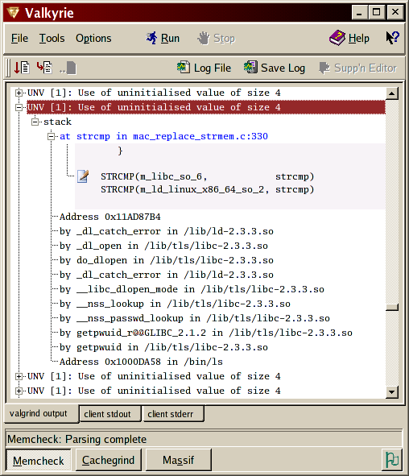
Tool: valgrind
Supports x86, older ARM chips
Full ARMv7 support coming soon
Multiple GUI front- ends

Slide 42
Multitasking
Running multiple applications simultaneously requires special care
You run out of memory, and device reboots
Background apps eat all your CPU, and you can’t answer phone calls
iPhone OS just tells your app it’s about to be killed
Your app must save state information to disk, so that it can resume smoothly when restarted
This is clever, because only one app at a time is in memory.

Slide 43
Multitasking
Android does automatic suspend/resume
Stores idle app state on disk automatically
Reloads app state when app is resumed, which causes occasional stalls
Maemo/MeeGo does regular Linux multitasking
cgroups to prioritize process groups in memory
Uses swap to extend physical memory, which causes occasional stalls
Android 2.2 has a task manager, where you can kill idle apps by hand.

Slide 44
User interface design
Mobile design patterns
Mobilize, Don’t Miniaturize
The Carry Principle
Context Sensitivity
New research coming out all the time
Including 3D interfaces in 1-2 years
Tricky to combine 3D and touch…

Slide 45
Multiplatform applications
Qt is supported “everywhere”
Encourages creation of multiplatform applications
But: even if the core application works everywhere, the user interface may not
#ifdef statements in code to instantiate different UI code for different UX environments?
QtMobility APIs to query system features

Slide 46
Web widgets
WebKit is the standard web runtime (WRT)
Provided by Android, Symbian, Maemo/MeeGo
Differences in JIT support
Platform service interfaces visible in JavaScript
Applications as widgets run in a WRT process context
Similar considerations as for native applications
Often possible to embed to native applications, sometimes just use in homescreen etc.

